Slide 1

Exploratory Data Analysis (EDA) for Real Estate Pricing
NextHikes IT Solutions begins
Riddhima Maheshwari

Slide 2

Dataset Overview
The Ames Housing dataset contains 1,460 residential property records with 81 features describing each home.
It includes variables related to location, lot size, building type, year built, quality, amenities, and sale price. This dataset is commonly used for house price prediction and real estate market analysis.

Slide 3

Data Preprocessing Steps
Handled missing values using median (numeric) and mode (categorical)
Confirmed no duplicate rows in the dataset
Verified no missing data remains in the dataset
Dataset has 1460 rows and 81 columns
Data types: 36 numeric, 45 categorical

Slide 4
Outlier Detection
Outliers were detected using the Interquartile Range (IQR) method
Features like EnclosedPorch, BsmtFinSF2, and OverallCond had the most outliers
Important to handle outliers to prevent skewed analysis and improve model accuracy

Slide 5
What is Univariate Analysis?
Univariate Analysis examines one variable at a time
Helps understand the distribution, central tendency, and spread of individual features
Useful for detecting outliers, skewness, and dominant categories
Lays the foundation for deeper statistical and machine learning analysis

Slide 6
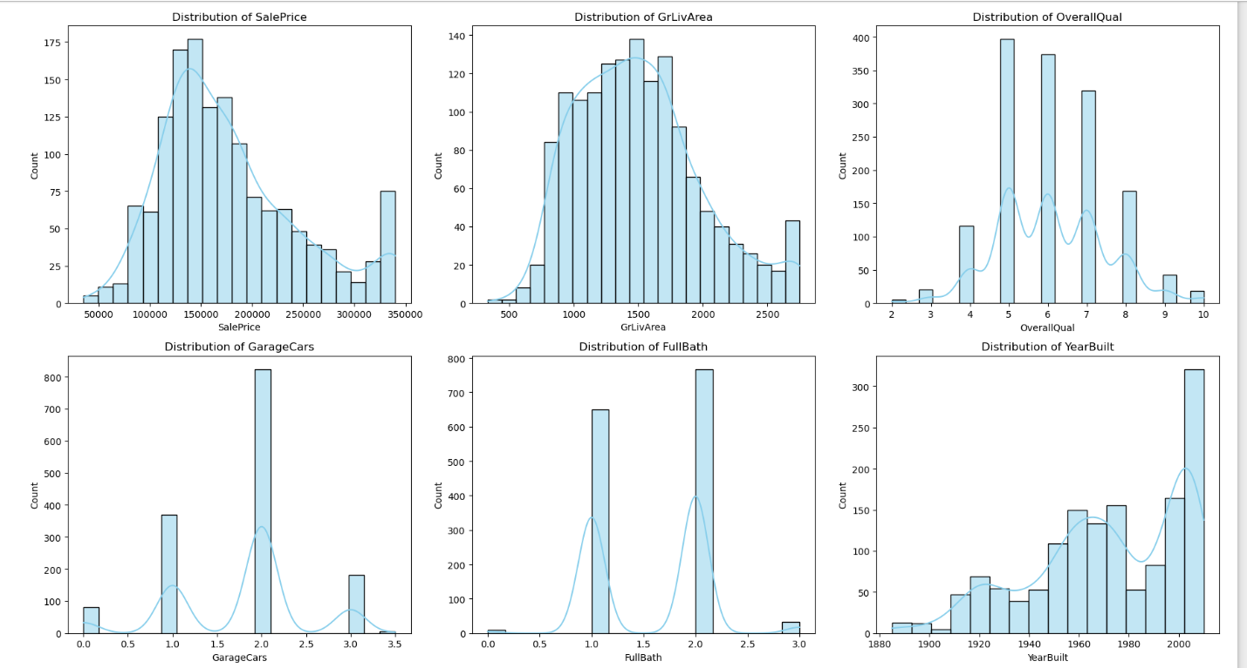
Univariate Analysis – Insights from Dataset
🔹 SalePrice: Right-skewed distribution, with most houses priced below 250,000
🔹 GrLivArea: Also right-skewed; larger homes are fewer, indicating outliers
🔹 OverallQual: Ratings peak at 5 to 7, showing most homes are of average to good quality
🔹 GarageCars: Majority of houses have space for 2 cars, with very few above 3
🔹 FullBath: Most homes have either 1 or 2 full bathrooms, indicating a consistent design trend
🔹 YearBuilt: Newer homes (post-2000) are more frequent, suggesting a modern housing boom

Slide 7
What is Bivariate Analysis?
Bivariate Analysis explores the relationship between two variables
Helps identify correlation, trends, or influence one variable may have on another
Used to uncover linear or non-linear patterns in data
Common tools: scatter plots, boxplots, and regression lines

Slide 8
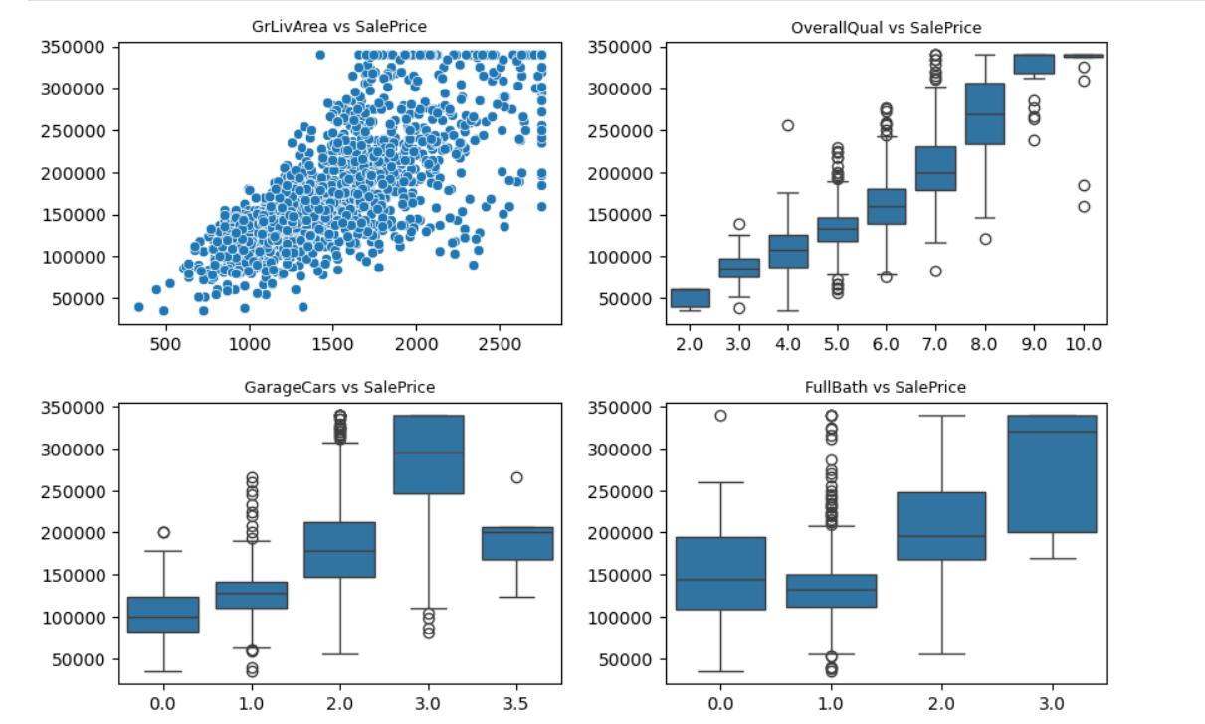
Bivariate Analysis – Insights from Dataset
🔹 GrLivArea vs SalePrice: A clear positive linear trend — larger living areas result in higher prices.
🔹 OverallQual vs SalePrice: Strong correlation — better quality homes tend to sell at significantly higher prices.
🔹 GarageCars vs SalePrice: Homes with 2 to 3 garage spaces fetch higher prices.
🔹 FullBath vs SalePrice: Price increases with the number of full bathrooms, peaking at 2–3 baths.

Slide 9
What is Multivariate Analysis?
Multivariate Analysis examines the relationship between three or more variables
Helps uncover complex interactions that influence the target variable
Useful for identifying combined effects and dependencies among features
Common tools: heatmaps, pairplots, multicolor scatter plots, and FacetGrid

Slide 10
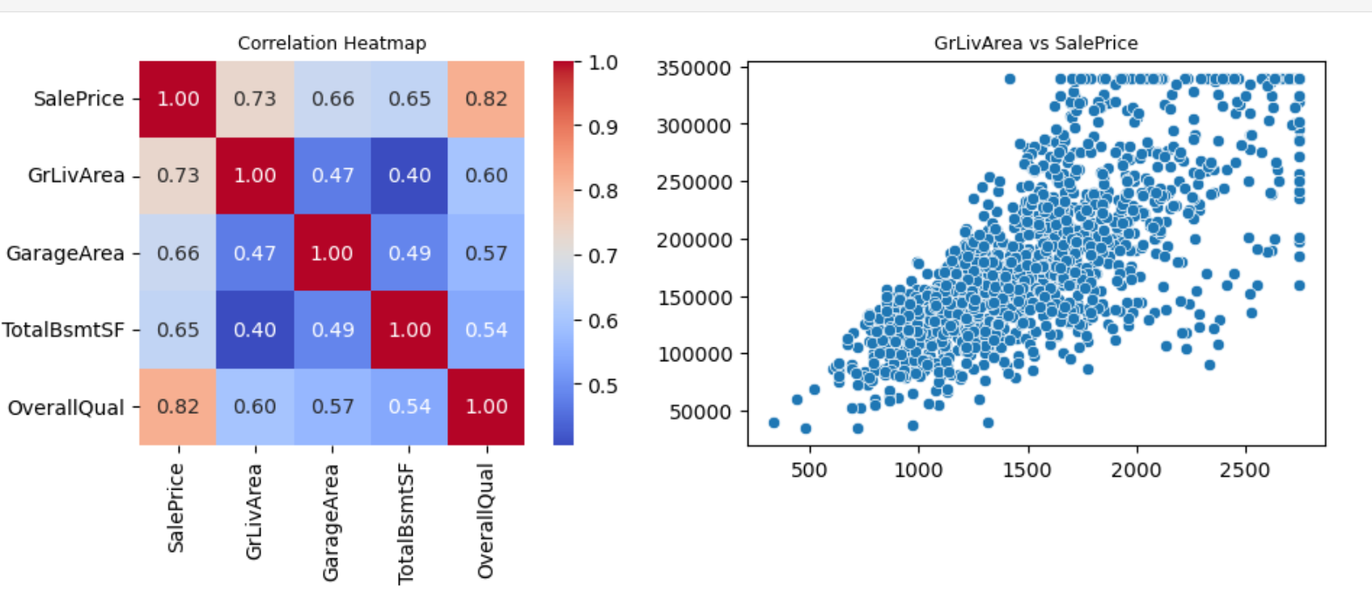
Multivariate Analysis – Insights from Dataset
🔸 OverallQual shows the strongest correlation with SalePrice (r = 0.82), highlighting quality as a major price driver.
🔸 GrLivArea is also strongly positively correlated (r = 0.73) — as seen in the scatter plot, larger homes fetch higher prices.
🔸 GarageArea, TotalBsmtSF, and Other size-related features show moderate positive correlation with price.
🔸 Features related to size and quality tend to jointly influence property valuation.

Slide 11
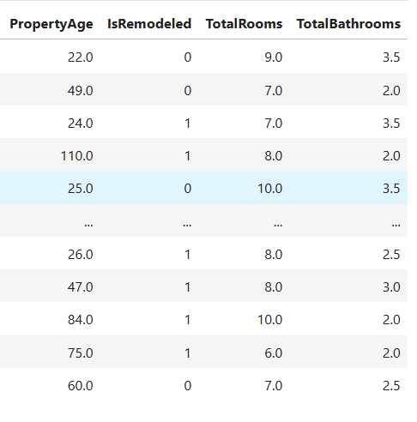
Feature Engineering
Created new feature PropertyAge to capture how old the house is
Added IsRemodeled to indicate whether the house was renovated
Combined room counts to form TotalRooms for better interior representation
Introduced TotalBathrooms by combining full and half baths to better represent bathroom capacity
Total columns increased to 83, including 4 engineered features

Slide 12
Feature Reduction
Dropped the column Condition2 from the dataset
It was nearly always identical to Condition1 and added no new information
Represented a rare secondary condition present in very few records
Removing it helps reduce redundancy and simplify the dataset
Final dataset now has 82 columns

Slide 13

References
https://www.geeksforgeeks.org/what-is-exploratory-data-analysis/
https://www.geeksforgeeks.org/what-is-feature-engineering/

Slide 14

Thank you!

